Slide 1
EA Waste Data Interrogator (2023-2024)
Regional Flow & Treatment Analysis
Prepared for Fishbone Solutions
Yasir Savanur

Slide 2

Part 1: Problem Statement & Descriptive Analytics

Slide 3
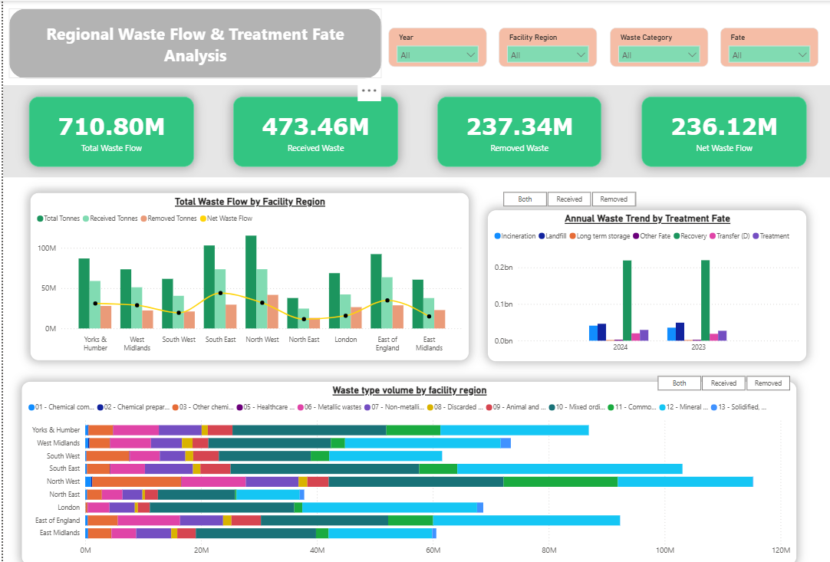
Objective: Analyse 2023-24 EA Waste Data to identify regional trends and fates

Slide 4
The Constraints: Massive dataset volume, complex file format and heavily fragmented reporting
The Risk: High probability of “double-counting” physical waste if Received and Removed pipelines are improperly merged

Slide 5
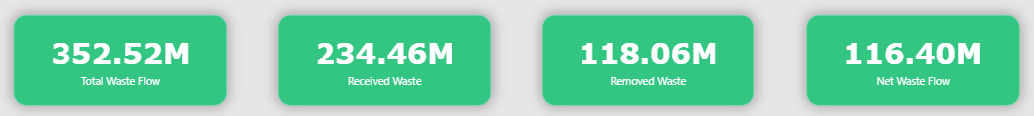
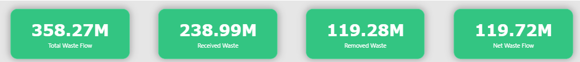
Across all facility regions, waste categories and fates in 2023-24:
Total Operational Handling = 710.8 MT
Inbound (Received) = 473.46 MT
Outbound (Removed) = 237.34 MT
Net Waste flow = 236.12 MT - Reveals the true regional capacity and physical accumulation
2023 KPIs
2024 KPIs

Slide 6
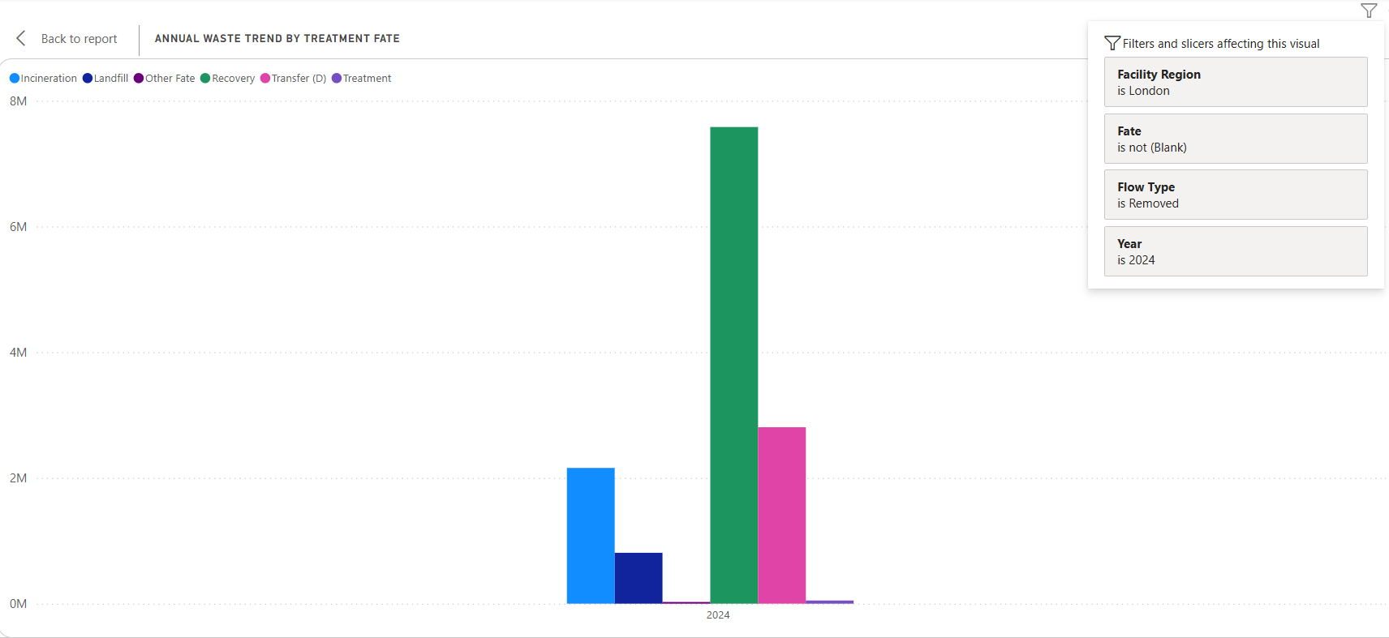
Addressing the Core Questions
Insight #1: Regional Volumes of Waste Fate
London (2024): High prioritisation of recovery (7.6 MT)
Negligible Landfill usage

Slide 7
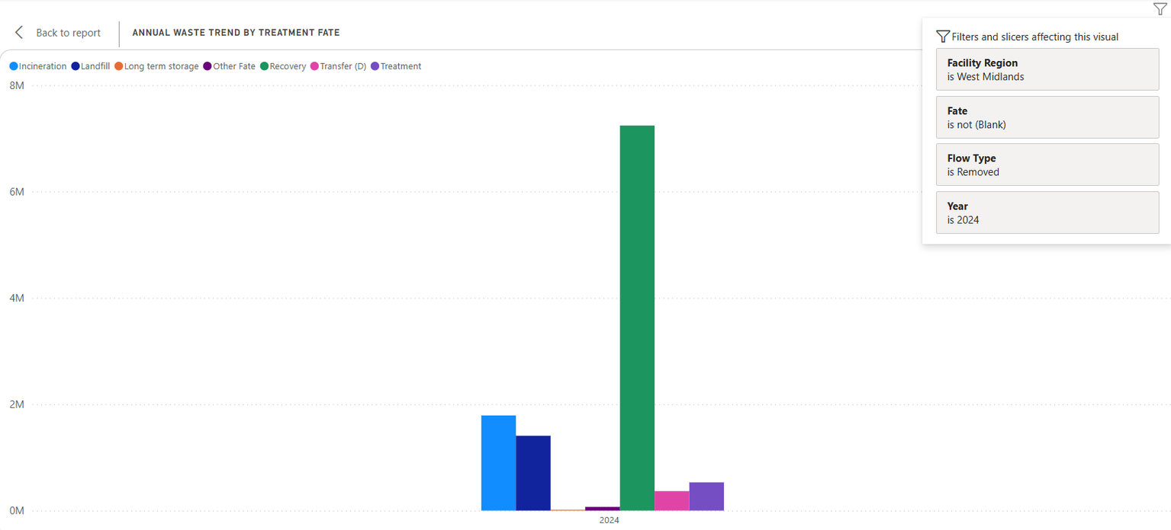
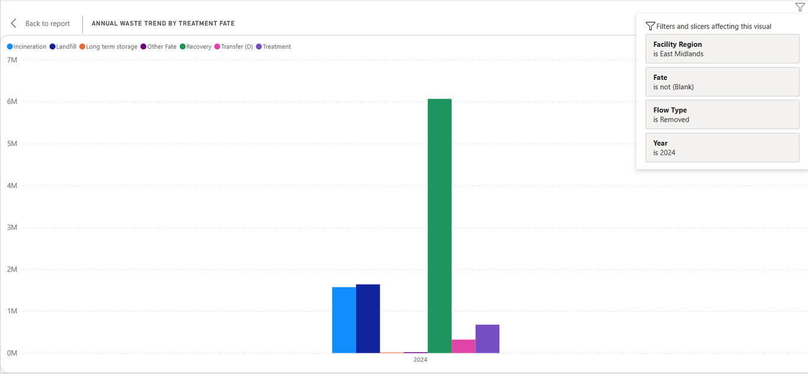
Regional Volumes of Waste Fate Insights continued
West Midlands (2024)
Transfer Fate = 366 KT
Treatment Fate = 530 KT
East Midlands (2024)
Transfer Fate = 320 KT
Treatment Fate = 677 KT
West Midlands
East Midlands

Slide 8
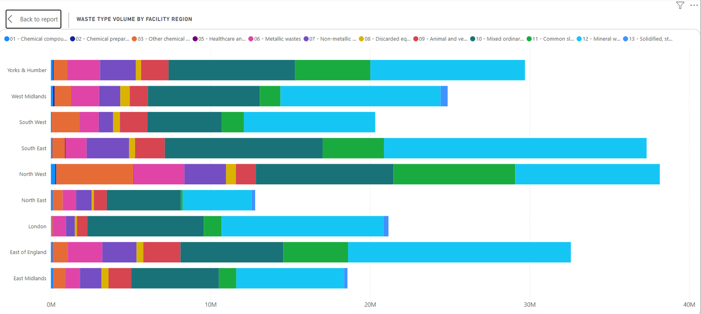
Insight #2: Regional Volumes by Waste Type
National Inbound (Received): Dominated by Mineral Wastes (Light blue)

Slide 9
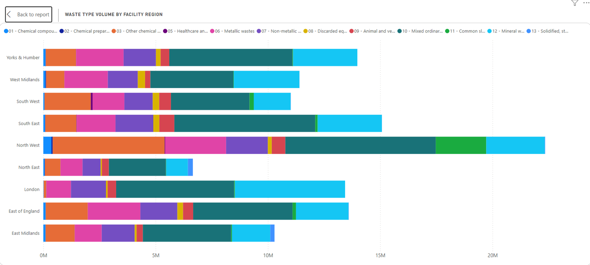
Regional Volumes by Waste Type Insights continued
National Outbound (Removed): Dominated by Mixed Ordinary Wastes (Dark green)

Slide 10
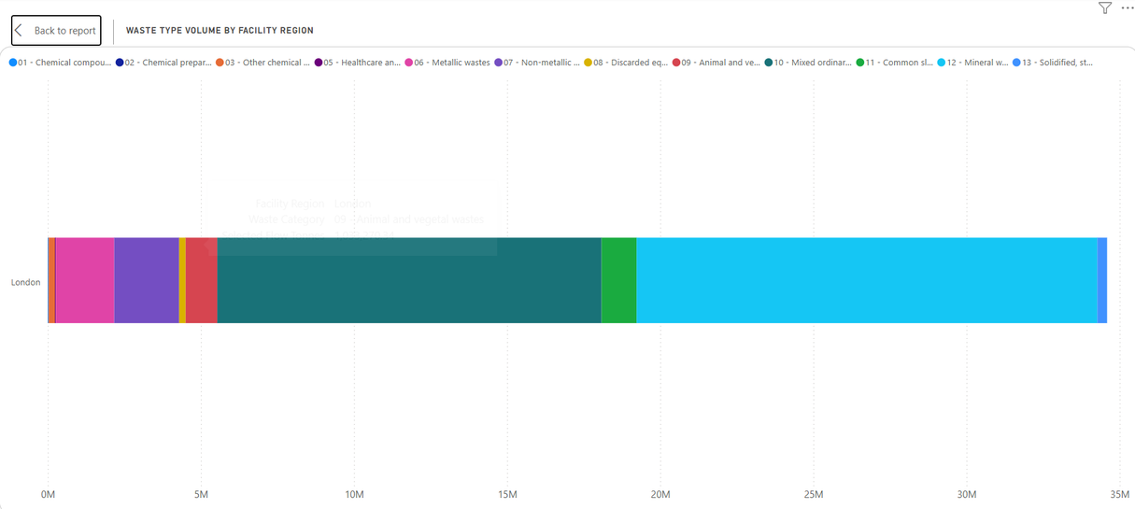
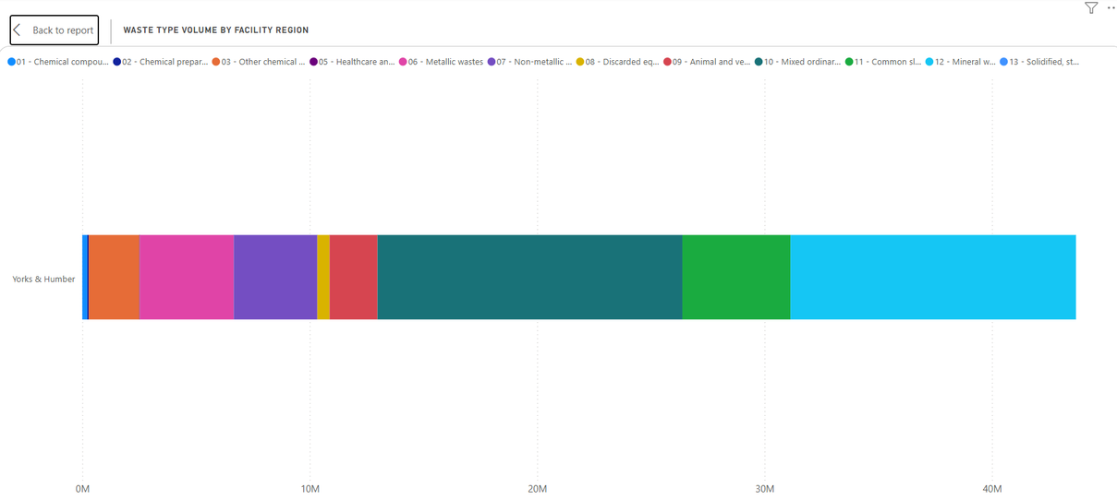
Regional Volumes by Waste Type Insights continued
Regional Contrast (2024)
London = Minerals > Mixed Ordinary Wastes
Yorkshire & Humber = Mixed Ordinary Wastes > Minerals

Slide 11
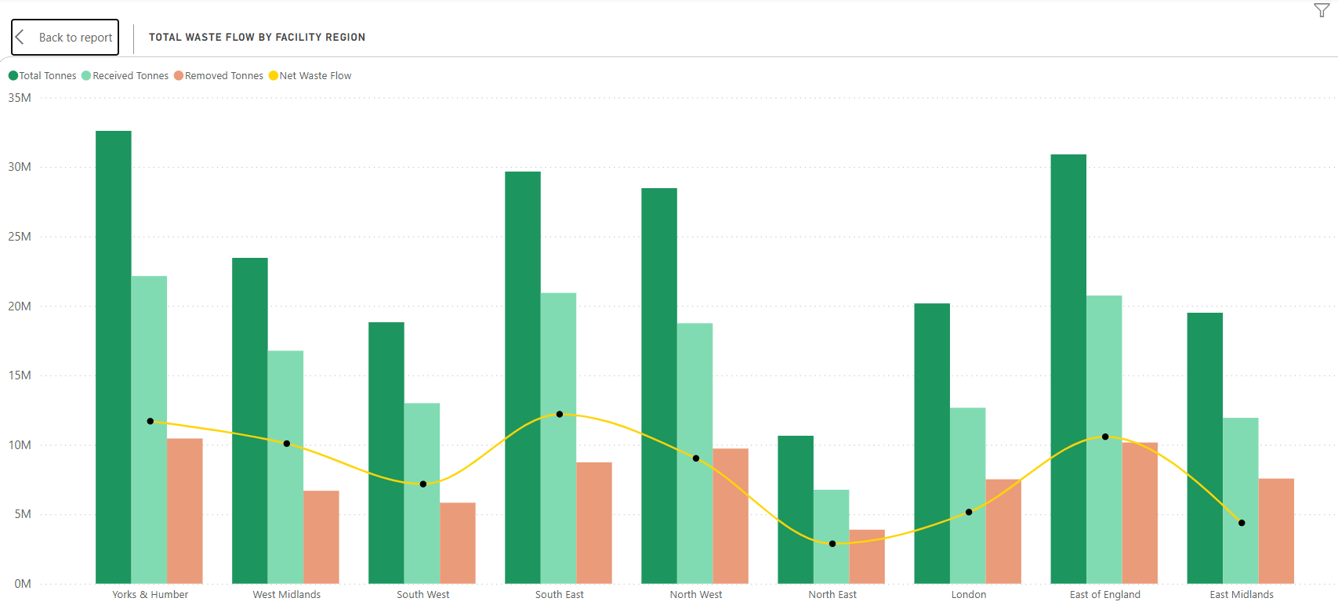
Insight #3: Trends in Volumes & Flow (2023 vs 2024)
Recovery Peaks (2023): Yorkshire & Humber led with 32.6 MT (11.7 MT Net Flow) whereas North East was lowest at 10.6 MT (2.8 MT Net Flow)

Slide 12
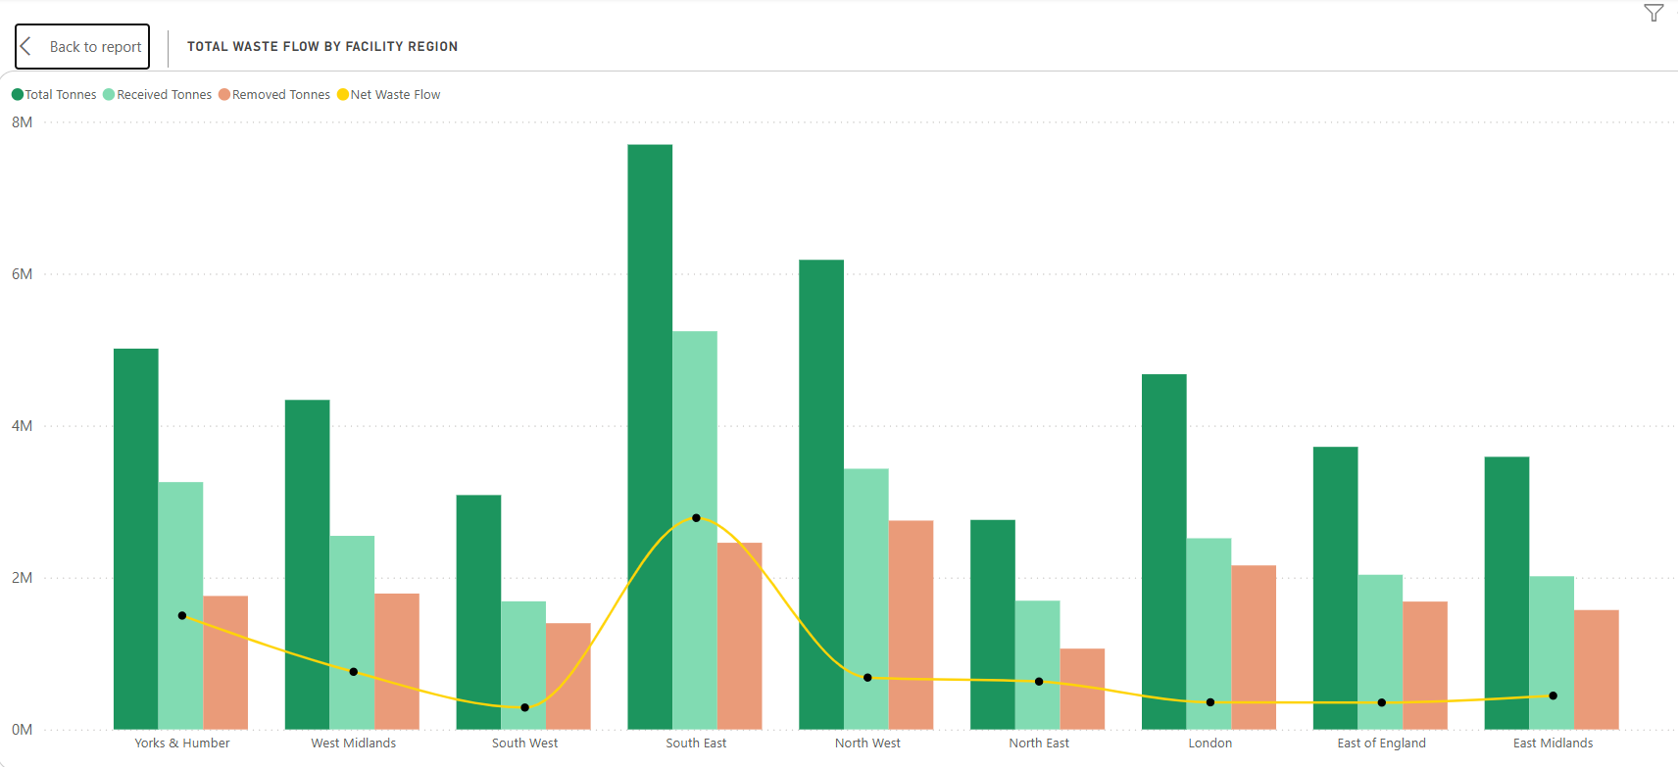
Trends in Volumes & Flow Insights continued
Incineration Peaks (2024): South East region led with 6.1 MT Total (1.7 MT Net Flow) wheras North East region was lowest at 2.4 MT

Slide 13
Part 2: Methodology & Data Engineering

Slide 14
Data Cleaning and ETL Pipeline
The Challenge: Massive .xslb risk crashing standard Power Query
The Solution: Scripted using Python for ingestion by incorporating pandas and pyxlsb
Automation: Utilised Regex to auto-extract and stamp ‘Year’ data directly from filenames
Output: Generated 2 different light, cleansed, merged .xlsx master files into categorising Received & Removed Waste Flows
Data Cleaning Note: The aim was to maintain the data integrity and despite containing missing & duplicate values, all the entries were retained to ensure the absolute totals & KPIs remained accurate.

Slide 15
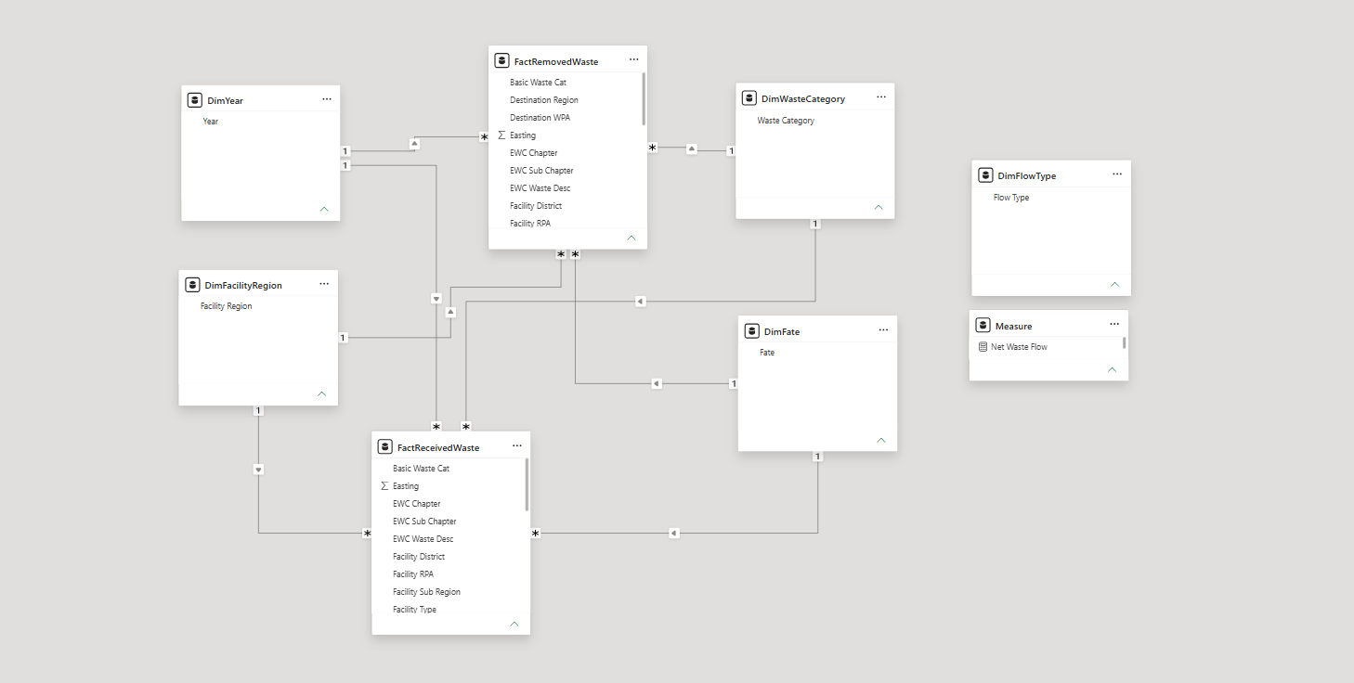
Dashboard Architecture (Power BI)

Slide 16
Dashboard Architecture continued
Core Logic: Segregated ‘FactReceived’ and ‘FactRemoved’ to analyse independently and to prevent double-counting
Dimensional Bridging: Linked ‘DimFacilityRegion’ and ‘DimYear’ and ‘DimWasteCategory’ to allow synchronised, cross-table filtering
UI Interface: Disconnected ‘DimFlowType’ table enables dynamic DAX measures for interactive flow toggling
Data Integrity: ‘Blank’ option in several slicers are due to EA commercial confidentiality and in turn retained witheld data to prevent bias.

Slide 17
Conclusion
Recommendations and Next Steps
Logistics Forecasting: By tracking the key variables with respect to its regions, we can accurately predict and optimise logistics and movement
Capacity Planning: Investigate anomalies eg., North West’s negative net flow to predict future facility capacity shortages
Commercial Data Governance: Establishing strict rules for handling ‘Confidential/Blank’ data ensures stakeholders make decision on absolute physical realities
Automate Client Reporting: This Python ETL-to-Power BI pipeline can be directly deployed to replace manual Excel tracking

Slide 18
Thank You

